Slide 1
Data Analytics
Group 6
Ankit Mishra (MT2014009)
Kumar Rahul (MT2014058)
Shan Mehrotra (MT2014111)

Slide 2
Data Preparation
Reviewed the data in Excel to gain insight.
We found the following observations:
All the students who were absent in the exams had ‘888’ as their obtained marks.
All the students whose marks were missing had result as NA.
A student failing in any one of the exams is overall declared fail.
Division of student is decided on the basis of available marks in exams excluding missing data.

Slide 3
Data Impurities
We found following impurities in data:
Marks columns had ‘*’ in numeric data.
DOB, Marks and many other columns had NA.
Outliers such as ‘888’ were present in the marks columns.
Marks columns contained ‘blanks’ while their corresponding result columns had NA in them.
Total Marks of many students were not equal to sum of marks of all exams.
Division (NRC_Class) was wrongly specified.

Slide 4
Data Cleaning
Removed the ‘*’ from the data using ‘gsub’ and converted the vector to numeric data.
g6$L1_MARKS <- as.numeric(gsub('[^a-zA-Z0-9.]', '', g6$L1_MARKS))
NA was present in many fields including non-numeric fields as well. We removed NA from numeric and date fields only.
g6$L1_MARKS[is.na(g6$L1_MARKS)] <- mean(g6$L1_MARKS, na.rm = T)
g6$DOB <- as.character(g6$DOB)
g6$DOB[is.na(g6$DOB)] <-"0/0/0000 0:00“

Slide 5
Contd…
Blanks were present in Marks fields. Corresponding Result was NA. We imputed the blanks with mean and replaced NA with ‘P’.
blanks <- is.na(g6$L1_RESULT)
g6$L1_MARKS[blanks] <- mean(g6$L1_MARKS, na.rm = TRUE)
g6$L1_RESULT[blanks] <- “P”
Replaced Outliers (888) with 0.
g6$L1_MARKS[g6$L1_MARKS == 888] <- 0

Slide 6
Contd…
Since the Marks were changed due to replacement with mean, Total Marks and NRC_Class (division) was recomputed.
g6$TOTAL_MARKS = g6$L1_MARKS + g6$L2_MARKS + g6$L3_MARKS + g6$S1_MARKS + g6$S2_MARKS + g6$S3_MARKS
Computation of Division
g6$NRC_CLASS <- as.character(g6$NRC_CLASS)
g6$NRC_CLASS[(g6$TOTAL_MARKS/650)*100 >= 80 & g6$NRC_RESULT == "P"] <- "D"

Slide 7
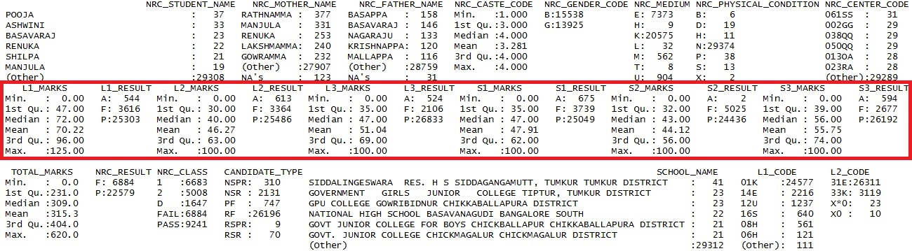
Exploratory Analysis
Summary of the data.

Slide 8
Contd..
Pie Chart to depict percentage distribution of division.
w = table(g6$NRC_CLASS)
t = as.data.frame(w)
perc <- round(t$Freq/sum(t$Freq)*100)
lbls <- paste(t$Var1, perc) # add percents to labels
lbls <- paste(lbls,"%",sep="") # ad % to labels
library(plotrix)
pie3D(t$Freq, labels = lbls, explode = 0.1, main = "Pie chart of Divisions")

Slide 9
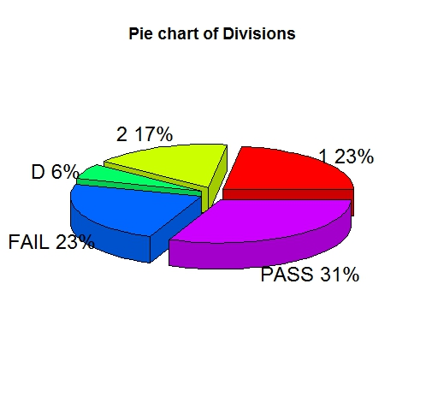

Slide 10
Contd..
Bar Graph showing area-wise distribution of passed students.
urb_pass_per <- (sum(g6$URBAN_RURAL == 'U' & g6$NRC_RESULT == 'P')/sum(g6$URBAN_RURAL == 'U'))*100
rur_pass_per <- (sum(g6$URBAN_RURAL == 'R' & g6$NRC_RESULT == 'P')/sum(g6$URBAN_RURAL == 'R'))*100
dat_pass <- data.frame(Area = factor(c("Urban","Rural"), levels=c("Urban","Rural")), Percentage = c(urb_pass_per, rur_pass_per))
ggplot(data=dat_pass, aes(x=Area, y=Percentage, fill=Area)) + geom_bar(stat="identity")

Slide 11
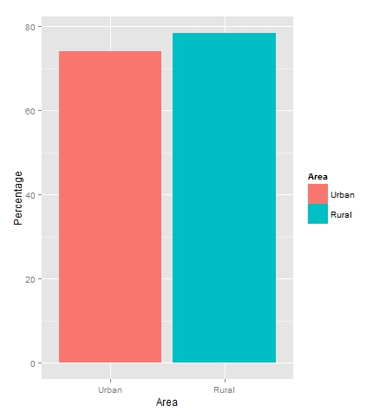

Slide 12
Contd..
Box Plot showing the comparison of marks in different exams.
color <- c("blue","green","red","yellow","purple","turquoise")
exam_name <- c("L1_Marks","L2_Marks","L3_Marks","S1_Marks","S2_Marks","S3_Marks")
boxplot(g6$L1_MARKS, g6$L2_MARKS, g6$L3_MARKS, g6$S1_MARKS,g6$S2_MARKS, g6$S3_MARKS, data = g6, col = color, names = exam_name, main = "Box Plot Comparision of Exams")

Slide 13
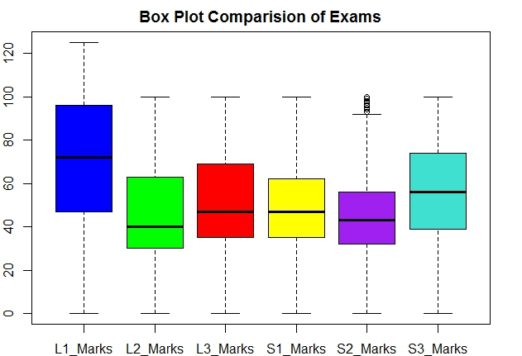

Slide 14
Contd..
Histogram & Density Plot depicting the percentage distribution of Boys & Girls.
boy_data <- filter(g6, NRC_GENDER_CODE == 'B')
Percentage <- (boy_data$TOTAL_MARKS/650)*100
ggplot(boy_data, aes(x=Percentage)) + geom_histogram(binwidth=2, color = "black", fill = "#FFFFE0")

Slide 15
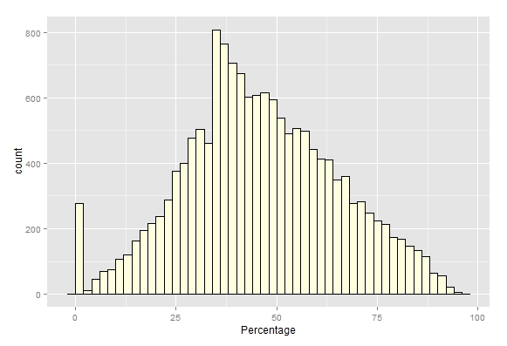
Histogram for Boys

Slide 16
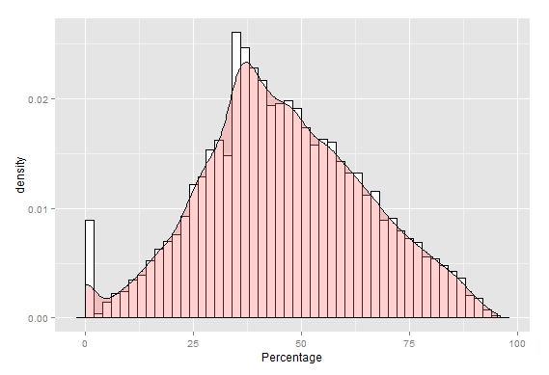
Density Plot for Boys

Slide 17
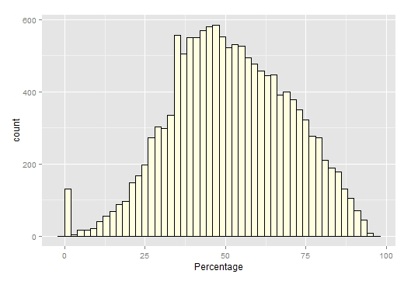
Histogram for Girls

Slide 18
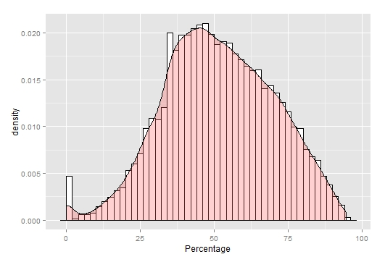
Density Plot for Girls

Slide 19
Contd..
Histogram showing percentage distribution of failed students.
fail <- filter(g6, NRC_RESULT == 'F')
fail_per <- (fail$TOTAL_MARKS/650)*100
ggplot(fail, aes(x=fail_per)) + geom_histogram(binwidth=2, color = "black", fill = "#FFFFE0")

Slide 20
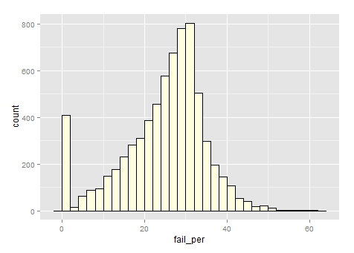

Slide 21
Thank you!!

